Slide 1

TELCO CHURN PREDICTION MODEL
Peerapat.t, Data scientist For project’s material please visit : github.com/peerapat-t

Slide 2
TABLE OF CONTENT
1. Business problem
Cost of acquiring a new customer
2. How to solve this problem
Do nothing
Retain all customers
Use a churn prediction model
3. Data
Target
Features
4. Solution
Churn prediction model performance
Promotion/campaign to retain customers
Use of model
4. Model
Data understanding
Technique used
Model evaluation
Feature importance
Future work
References
About author
Churn prediction model

Slide 3
1. BUSINESS PROBLEM
1.1 Cost of acquiring a new customer
The cost of retaining a customer is typically much lower than the cost of acquiring a new customer.
For example, a study by Bain & Company found that it costs 5 to 7 times more to acquire a new customer than it does to retain an existing customer.
This is because existing customers are already familiar with your product or service and they are more likely to continue doing business with you.
Churn prediction model

Slide 4
2. HOW TO SOLVE THIS PROBLEM
2.1 Do nothing
Business not take any action to retain customers.
2.2 Retain all customers
Business take action to retain every customer.
2.3 Use a churn prediction model
Business use churn prediction to predicts who are at risk of churning.
Churn prediction can help businesses identify customers who are at risk of leaving.
This allows businesses to take action to retain those customers, such as offering them discounts or special promotions.
Option | Cost | Effectiveness
Do nothing | Least expensive | Least effective
Retain all customers | Most expensive | Most effective
Use a churn prediction model | More cost-effective than retaining all customers | More effective than doing nothing
Churn prediction model

Slide 5
3. DATA
3.1 Target
There are 7,032 customers in the dataset, including churn and not-churn customers.
Churn customers are those who have unsubscribed within the last month.
Customer account information: This includes how long they've been a customer, contract, payment method, paperless billing, monthly charges, and total charges.
Demographic info about customers: This includes gender, age range, and if they have partners and dependents.
3.2 Features
The dataset contains 22 features, which can be categorized into 3 groups:
Services that each customer has signed up for: This includes phone, multiple lines, internet, online security, online backup, device protection, tech support, and streaming TV and movies.
Churn prediction model

Slide 6
4. SOLUTION
4.1 Churn prediction model performance
Option | Total (Test) | Actual churn | Overspend (FP) | Save (TP) | Gains (or Loss)
Do nothing | 1,407 | 374 | 0 | 0 | -187,000
Retain all | 1,407 | 374 | 1,033 | 374 | 83,700
Churn prediction model | 1,407 | 374 | 307 | 295 | 110,700
* These calculations are based on the assumption that the cost of promotion is 100, the cost of loss is 500, and the savings per customer is 500.
Utilizing data from the test set involving approximately 1,407 customers, the churn prediction model yielded a gain of 159.03% when compared to the 'do nothing' program, and 32.23% when compared to the 'retain all' program.
Churn prediction model

Slide 7
4. SOLUTION
4.2 Promotion/campaign to retain customers
For customers who have signal of churning and using a top-up package, we should introduce promotions to transition them to a contract package. Additionally, provide a limited-time offer like free 10GB internet for 6 months.
For customers who have signal of churning and they are elder, we should offer a budget-friendly package accompanied by a message like "Stay connected with your number.
For customers who have signal of churning and using a low-price package, we should be presented with a comparison of our package against competitors' offerings, followed by a strategic response.
For customers who have signal of churning and no current internet service, we should introduce an affordable internet package.
For customers who have signal of churning and still pay bills physically, we should encourage them to explore more convenient payment options, such as automatic credit card billing.
Churn prediction model

Slide 8
4. SOLUTION
4.3 Use of model
Predict customer who are at risk to churn in the next month using the model and send leads to marketing team for retention campaign.
Train/Val
Test
Prediction
202201-202212
202301
202302-
Churn prediction model

Slide 9
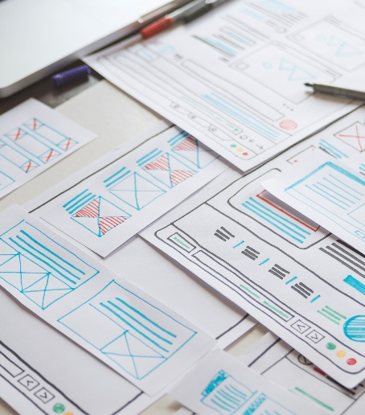
END OF BUSINESS SESSION
Churn prediction model

Slide 10
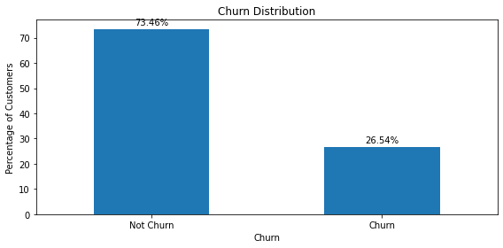
4. MODEL
4.1 Data understanding
If we look at the target distribution, There are only 27% of churn customers that the data is imbalanced.
Resampling method or threshold tuning should be applied to handle this problem.
Metrics like accuracy can be misleading and ineffective. Instead, it is essential to explore alternative evaluation measures, such as precision, recall, F1-score, or AUC-ROC.
Churn prediction model

Slide 11
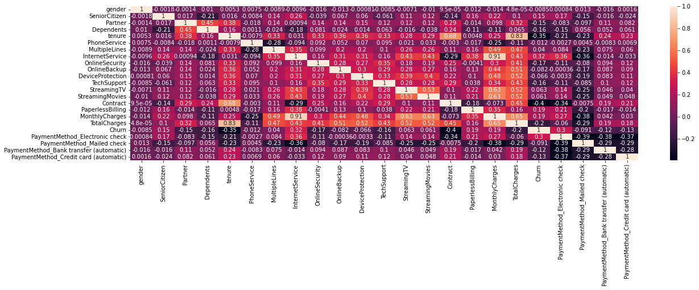
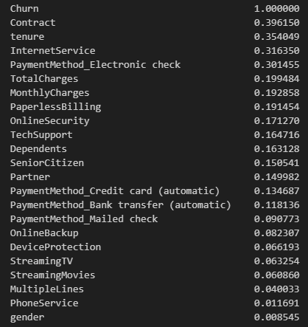
4. MODEL
4.1 Data understanding (cont.)
4 features, including contract, tenure, internet service, and electronic payment method, exhibit a high correlation (greater than 0.3 in absolute terms) with the target variable."
Churn prediction model

Slide 12
4. MODEL
4.2 Technique used
Step | Topic | Cost
1 | Dataset | Split the data into train, test, and validation sets. Use the train set to train the model, the validation set to tune the threshold, and the test set to evaluate the model.
2 | Normalized | Use Min-Max scaling to normalize the data.
3 | Resampling | Try oversampling (SMOTE) and undersampling (random undersampling).
4 | Model | Try random forest, LightGBM, and XGBoost.
5 | Hyperparameter tuning | Use RandomizedCV to find the best hyperparameters for each model.
6 | Threshold tuning | Use cost-sensitive learning to tune the threshold. Assign a cost of 5 times more to acquiring new customers than to retaining existing customers.
7 | Interpreting | Use SHAP values.
Churn prediction model

Slide 13
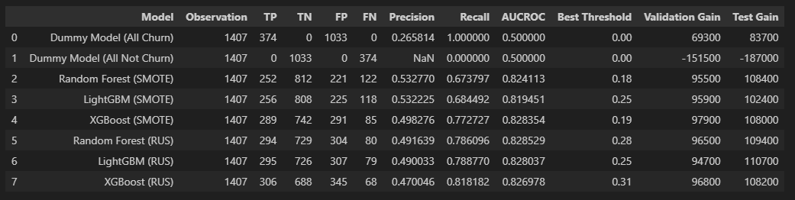
4. MODEL
4.3 Model evaluation
Before performing threshold tuning, XGBoost (RUS) seems good because it has a high AUCROC and the highest Recall.
However, prior to that, LightGBM (RUS) is the better model as it achieves maximum gains.
Ultimately, for the final decision, we choose LightGBM (RUS) to deploy in our system."
Churn prediction model

Slide 14
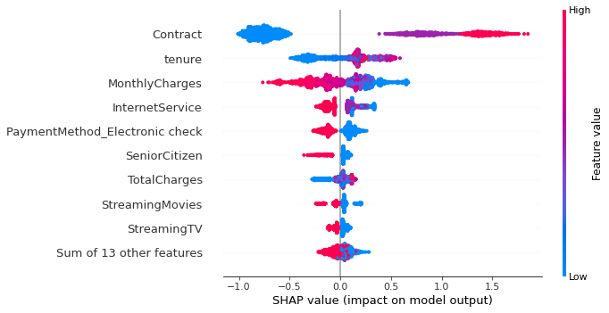
4. MODEL
4.4 Feature importance (cont.)
Features | Sign | Meaning
Contract | + | Customers on contract or top-up plans are more likely to churn, possibly due to the ease of changing numbers for top-up customers.
Tenure | + | Long-time customers have a higher churn probability, potentially due to elderly individuals reducing phone usage to cut expenses.
Monthly charges | - | Customers paying lower charges are more likely to churn, influenced by industry trends towards appealing, low-priced packages from other operators.
Internet service | - | Customers without internet in their package are at a higher churn risk, as competitors offer inclusive internet services, reflecting its growing importance.
Payment method (electronic check) | - | Non-users of electronic payment for bills are more likely to churn, possibly due to the inconvenience of payment, prompting a switch to other providers.
Churn prediction model

Slide 15
5. FUTURE WORK
Improve model performance by creating more features and performing feature engineering.
Experiment with different machine learning models, such as SVC and deep learning.
Tune hyperparameters using sequential search techniques, such as Optuna.
Segment customers using clustering and retain them with personalized promotions.
Churn prediction model

Slide 16
END OF PRESENTATION
Churn prediction model

Slide 17
6. REFERENCE
https://medium.com/@stephen.blount99/putting-a-price-on-customer-churn-38a184e530b8
https://www.kaggle.com/code/bandiatindra/telecom-churn-prediction
https://machinelearningmastery.com/smote-oversampling-for-imbalanced-classification/
Churn prediction model

Slide 18
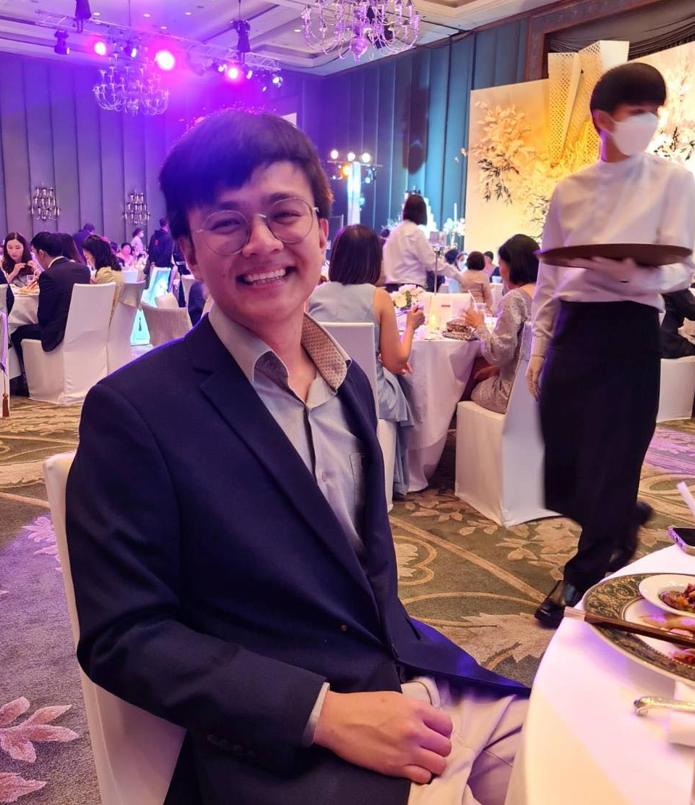

7. ABOUT AUTHOR
Peerapat Tancharoen holds a Bachelor's degree in Economics from Srinakharinwirot University, graduating with first honors and a GPA of 3.67. He also earned a Master's degree in Economics from Thammasat University, achieving a GPA of 3.98.
This project tries to use techniques such as oversampling, undersampling, and cost-sensitive to handle imbalanced data, which is a challenge for most data science projects in the real world.
Contact me on
linkedin.com/in/peerapat-tancharoen-664759220/
peerapat.tcr@gmail.com
Churn prediction model

